Slide 1
AFC Elite Education Seminar 2012
Elite Referee Assessor Course
Kuala Lumpur, Malaysia
2 - 4 February 2012
AFC Referees Department

Slide 2
The Role of an AFC Assessor
Aim
The aim of this session is to review what your role is as a AFC Elite Referee Assessor

Slide 3
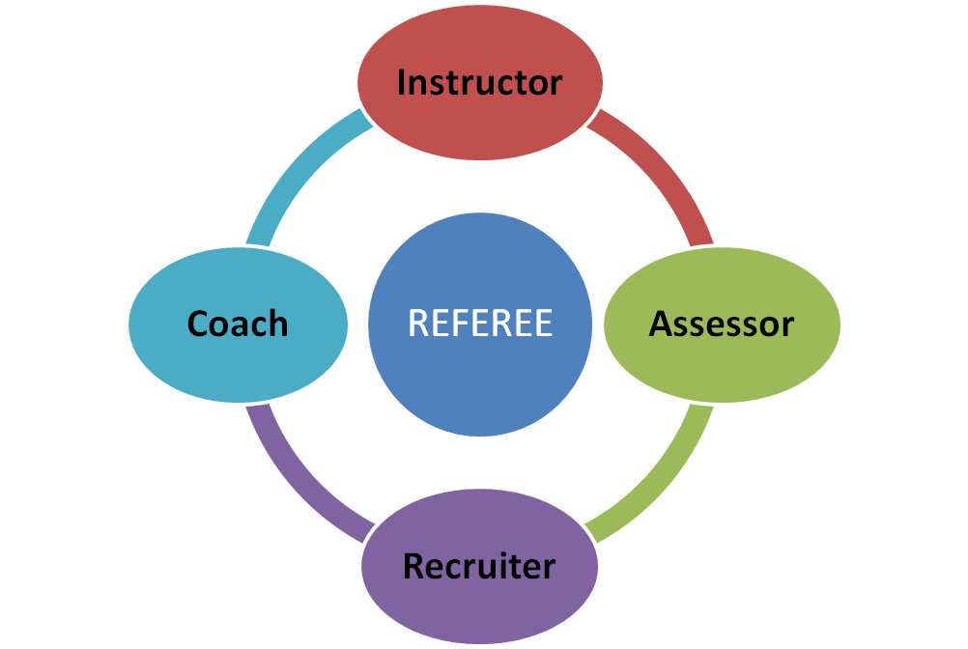
The Referee – Assessor relationship

Slide 4
The Role of an AFC Assessor
Group Exercise
In your groups, what is the role of the assessor?

Slide 5
The Role of an AFC Assessor
To identify potential
To aid in the development of referees
To offer positive advice
To monitor progress
To give honest opinions
To be constructive

Slide 6
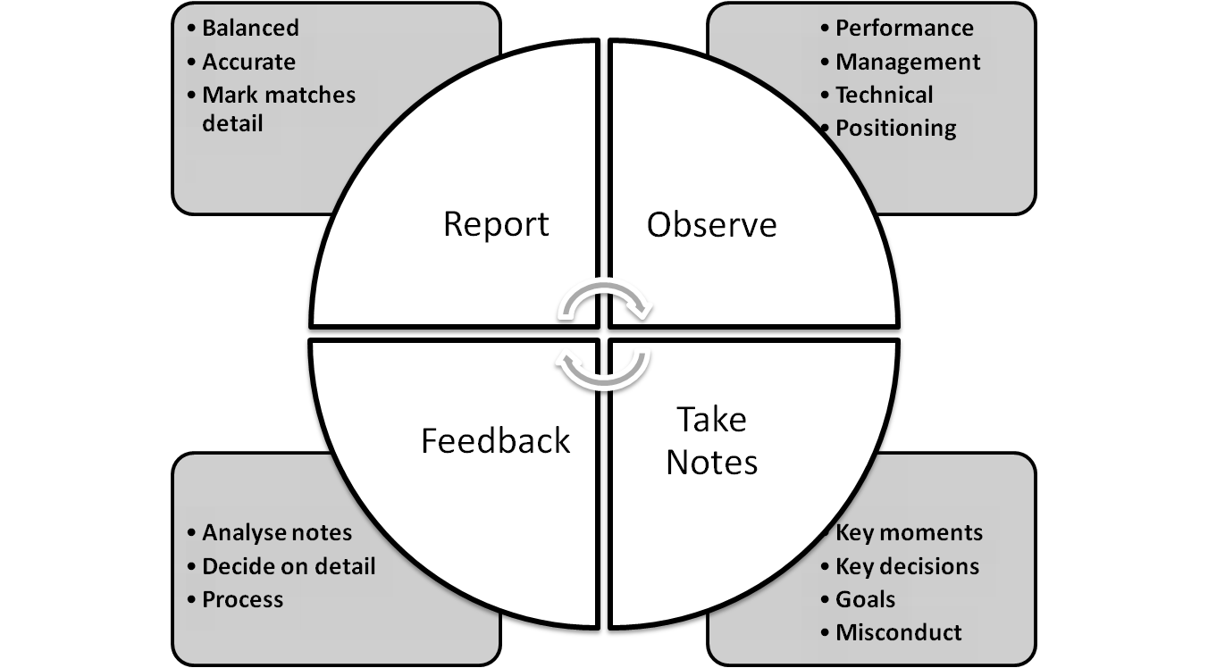
The Role of an AFC Assessor

Slide 7
THE ROLE OF AN ELITE ASSESSOR
Provide the Referee with helpful advice and constructive criticism of one best qualified to assess through experience and training
Stimulate all independently assessed officials to adopt the process of guided self- analysis after every game

Slide 8
ADVICE
MUST BE
1. CONSTRUCTIVE
Advise, Do Not Destroy
2. FAIR
Good News, then Critique, Finally, Good News
3. FRIENDLY
Never provoke or make to feel inferior; your attitude is vital
4. FIRM
Honesty is essential; stress major points rather than minor ones
5. PLANNED
Ensure that every aspect is covered

Slide 9

Any Questions?
THANK YOU!

